Slide 1
Maximizing SSIS Package Performance
Tim Mitchell

Slide 2
Today’s Agenda
Overview of SSIS performance
Troubleshooting methods
Performance tips

Slide 3
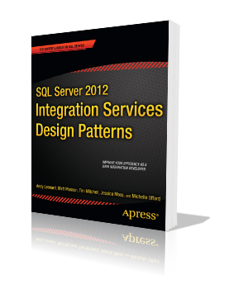
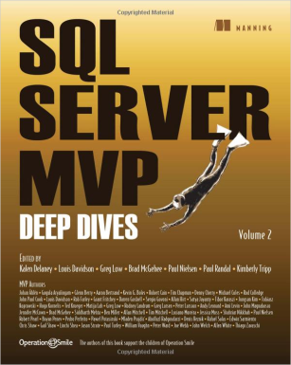
Tim Mitchell
Business intelligence consultant
Partner, Linchpin People
SQL Server MVP
TimMitchell.net / @Tim_Mitchell
tim@timmitchell.net

Slide 4
Housekeeping
Questions
Slide deck

Slide 5
Performance Overview

Slide 6
Performance Overview
Two most common questions about SSIS package executions:
Did it complete successfully?
How long did it run?

Slide 7
Performance Overview
Why is ETL performance important?
Getting data to the right people in a timely manner
Load/maintenance window
Potentially overlapping ETL cycles
The most important concern: bragging rights!

Slide 8
Troubleshooting
SSIS Performance

Slide 9
Troubleshooting SSIS Performance
Key questions:
Is performance really a concern?
Is it really an SSIS issue?
Which task(s) or component(s) are causing the bottleneck?

Slide 10
Troubleshooting SSIS Performance
Is this really an SSIS issue?
Test independently, outside SSIS
Compare results to SSIS

Slide 11
Troubleshooting SSIS Performance
Where in SSIS is the bottleneck?
Logging is critical
Package logging (legacy logging)
Catalog logging (SQL 2012 only)

Slide 12
Troubleshooting SSIS Performance
SELECT execution_id, package_name, task_name, subcomponent_name
, phase, MIN(start_time) [Start_Time], MAX(end_time) [End_Time]
FROM catalog.execution_component_phases
WHERE execution_id =
(SELECT MAX(execution_id) from [catalog].[execution_data_statistics])
GROUP BY execution_id, package_name, task_name, subcomponent_name, phase
ORDER BY 6

Slide 13
Troubleshooting SSIS Performance
Brute force troubleshooting: Isolation by elimination
Disable tasks
Remove components

Slide 14
Troubleshooting SSIS Performance
Monitor system metrics
Disk IO
Memory
CPU
Network

Slide 15
Performance
Tips

Slide 16
Tip #1: Tune your sources and destinations
Many performance problems in SSIS aren’t SSIS problems
Sources and destination issues are often to blame

Slide 17
Tip #1: Tune your sources and destinations
Improper data retrieval queries
Index issues
Network speed/latency
Disk I/O

Slide 18
Tip #2: Using OPTION (FAST <n>)
Directs the query to return the first <n> rows as quickly as possible
SELECT FirstName, LastName, Address, City, State, Zip
FROM dbo.People
OPTION (FAST 10000)
Not intended to improve the overall performance of the query

Slide 19
Tip #2: Using OPTION (FAST <n>)
Useful for packages that spend a lot of time processing data in data flow
Query time from SQL Server source
Processing time in SSIS package
Without OPTION (FAST <n>)
Load time to destination

Slide 20
Tip #2: Using OPTION (FAST <n>)
Useful for packages that spend a lot of time processing data in data flow
Query time from SQL Server source
Using OPTION (FAST <n>)
Processing time in SSIS package
Load time to destination

Slide 21
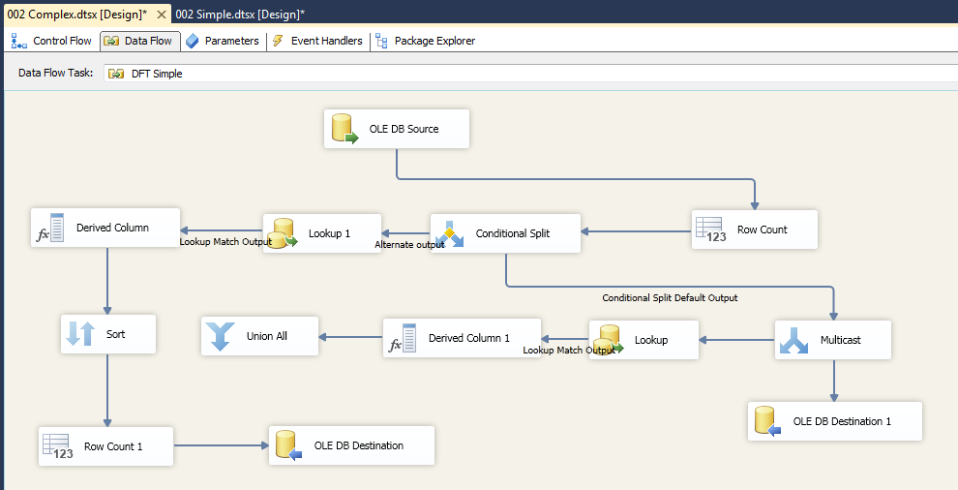
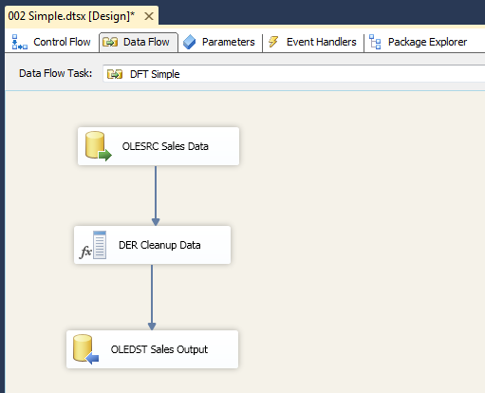
Tip #2: Using OPTION (FAST <n>)

Slide 22
Tip #3: Blocking transformations
Know the blocking properties of transformations
Nonblocking
Partially blocking
Fully blocking

Slide 23
Tip #3: Blocking transformations
Nonblocking – no holding buffers
Row count
Derived column transformation
Conditional split

Slide 24
Tip #3: Blocking transformations
Partially blocking – some buffers can be held
Merge Join
Lookup
Union All

Slide 25
Tip #3: Blocking transformations
Fully blocking – everything stops until all data is received
Sort
Aggregate
Fuzzy grouping/lookup

Slide 26
Tip #3: Blocking transformations
Partially or fully blocking transforms are not evil! Pick the right tool for every job.

Slide 27
Tip #3: Blocking transformations
Demo – Blocking Transformations

Slide 28
Tip #4: Slow transformations
Some transformations are often slow by nature
Slowly Changing Dimension wizard
OleDB Command

Slide 29
Tip #4: Slow transformations
Useful for certain scenarios, but should not be considered go-to tools for transforming data

Slide 30
Tip #5: Avoid the table list
Table list = SELECT * FROM…
Can result in unnecessary columns
A narrow buffer is happy buffer

Slide 31
Tip #5: Avoid the table list
Use the query window to select from table, specifying only the required columns
Writing the query can be a reminder to apply filtering via WHERE clause, if appropriate

Slide 32
Tip #6: RunInOptimizedMode
Data flow setting to prevent the allocation of memory from unused columns
Note that you’ll still get a warning from SSIS engine

Slide 33
Tip #7: Transform data in source
When dealing with relational data, consider transforming in source
Let the database engine do what it already does well

Slide 34
Tip #7: Transform data in source
Sorting
Lookups/joins
Aggregates

Slide 35
Tip #8: Concurrent executables
Package-level setting to specify how many executables can be running at once
Default = -1
Number of logical processors + 2

Slide 36
Tip #8: Concurrent executables
For machines with few logical processors or potentially many concurrent executables, consider increasing this value

Slide 37
Tip #8: Concurrent executables
Demo – Concurrent Executables

Slide 38
Tip #9: Go parallel
Many operations in SSIS are done serially
For nondependent operations, consider allowing processes to run in parallel

Slide 39
Tip #9: Go parallel
Dependent on machine configuration, network environment, etc.
Can actually *hurt* performance
Testing, testing, testing!

Slide 40
Tip #10: Don’t be afraid to rebel
Sometimes a non-SSIS solution will perform better than SSIS
If all you have is a hammer…

Slide 41
Tip #10: Don’t be afraid to rebel
Some operations are better suited for T-SQL or other tools:
MERGE upsert
INSERT…SELECT
Third party components
External applications (via Execute Process Task)

Slide 42
Tip #11: Watch your spools
Buffers spooled = writing to physical disk
Usually indicates memory pressure
Keep an eye on PerfMon counters for SSIS: Buffers Spooled

Slide 43
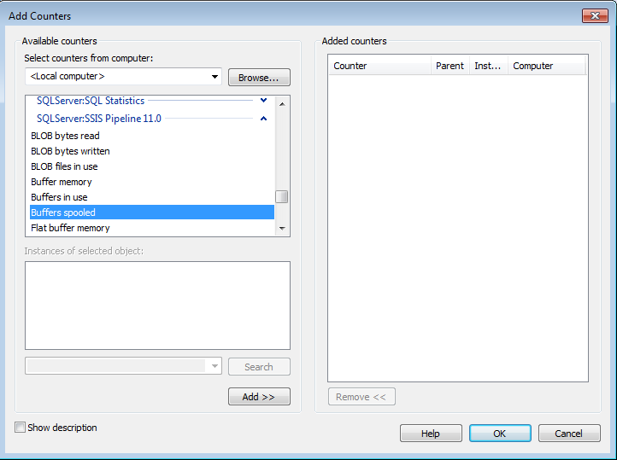
Tip #11: Watch your spools

Slide 44
Tip #11: Watch your spools
Any value above zero should be investigated
Keep it in memory!

Slide 45
Tip #12: Buffer sizing
Data flow task values:
DefaultBufferSize
DefaultBufferMaxRows
Ideally, use a small number of large buffers
Generally, max number of active buffers = 5

Slide 46
Tip #12: Buffer sizing
Buffer size calculation:
Row size * est num of rows / DefaultMaxBufferRows

Slide 47
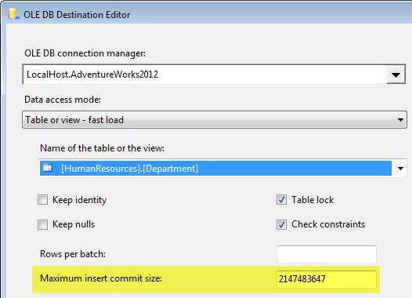
Tip #13: MaximumInsertCommitSize
OleDbDestination setting
Controls how buffers are committed to the destination database

Slide 48
Tip #13: MaximumInsertCommitSize
MICS > buffer size | Setting is ignored. One commit is issued for every buffer.
MICS = 0 | The entire batch is committed in one big batch.
MICS < buffer size | Commit is issued every time MICS rows are sent. Commits are also issued at the end of each buffer.
Source: Data Loading Performance Guide http://technet.microsoft.com/en-us/library/dd425070(v=sql.100).aspx

Slide 49
Tip #13: MaximumInsertCommitSize
Note that this does NOT impact the size of the buffer in SSIS

Slide 50
Tip #13: MaximumInsertCommitSize
In most cases, a small number of large commits is preferable to a large number of small commits

Slide 51
Tip #13: MaximumInsertCommitSize
Larger commit sizes = fewer commits
Good:
Potentially less database overhead
Potentially less index fragmentation
Bad:
Potential for log file or TempDB pressure/growth

Slide 52
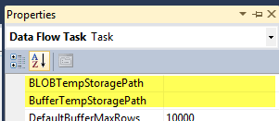
Tip #14: Prepare for paging buffers
Plan for no paging of buffers to disk. But….
Build for it if (when?) it happens
BLOBTempStoragePath
BufferTempStoragePath
Fast disks if possible

Slide 53
Tip #15: Manage your lookups
Lookup cache modes
Full (default)
Partial
None

Slide 54
Tip #15: Manage your lookups
Full cache:
Small- to medium-size lookup table
Large set of data to be validated against the lookup table
Expect multiple “hits” per result

Slide 55
Tip #15: Manage your lookups
Partial cache:
Large lookup table AND reasonable number of rows from the main source
Expect multiple “hits” per result

Slide 56
Tip #15: Manage your lookups
No cache:
Small lookup table
Expect only one “hit” per result

Slide 57
Tip #15: Manage your lookups
Demo – Lookups and caching

Slide 58
Tip #16: Share the road
Strategically schedule packages to avoid contention with other packages, external processes, etc.
Consider a workpile pattern in SSIS

Slide 59
Tip #16: Share the road
Resource contention is a key player in SSIS performance issues
Other SSIS or ETL processes
External processes

Slide 60
Tip #17: Stage your data
SQL-to-SQL operations perform well
Can’t do direct SQL to SQL with nonrelational or external data

Slide 61
Tip #17: Stage your data
Staging the data can allow for faster, direct SQL operations
Remember: Let the database engine do what it does well.
Updates in particular

Slide 62
Tip #17: Stage your data
Demo – Staged Update

Slide 63
Additional Resources
Rob Farley demonstrates FAST hint: http://bit.ly/eYNlMg
Microsoft data loading performance guide: http://bit.ly/17xjgbw

Slide 64
Thanks!
tim@timmitchell.net
TimMitchell.net/Newsletter

